Slide 1
Optical Systems
Interactions using FDS
Description of each
How they work
Advantages and disadvantages of each
Choosing which to use

Slide 2

Optical system requirements
Imaging
Optics
Source
Cell
Detector
Radial resolution
Sensitivity
Range
Linearity
Time to scan

Slide 3
Absorbance Optical System
Source overview
Torroidal grating
Source intensity
Wavelength selection
Source

Slide 4
Synchronizing sources
Magnet
Magnet detector
Sample pulse
Reference pulse
1
Rotor pulse
Clock
Lamp pulse

Slide 5
Absorbance detector
Top View
Cell
Radial motion
Photomultiplier
Tube

Slide 6
Absorbance signal processing
Light
Rotor timing pulse
Gating
Counter
Data
Acquisition
Board
PMT
hv set
16-bit count
Gain
f
i
V
Vxg
Transconductance
amplifier
PGA
Sample and Hold
and V/f converter

Slide 7
Absorbance signal
A = log (I_{o}/I)
  Low I_{o} results in high noise level
  Save data as intensities
Noise is high frequency
  Stochastic- rms 1/N^{1/2}
    Diminishing returns beyond N=9
  Dependent on signal levels
  Best between 0.1-1.0 A

Slide 8
Absorbance system facts
Xenon lamp intensity ‘spiky’ and blue
  Maximum light intensity 230 nm
  Work at high intensity regime
Maximum repetition rate 100 Hz
  Limits scan rate above 6000 rpm
Scales gain on reference intensity
  Uses 6.5 cm
  ‘Invert’ sample and reference may not work

Slide 9
When to use Absorbance
Need selectivity
Added sensitivity
Cannot dialyze sample

Slide 10
Absorbance system ‘gotchas’
Low intensity!
  Weak lamp output
  Buffer absorbs
Schlieren distortion at high gradients
  Light deviated out of system
  Typically overestimate A(r)
Slit to lamp image tracking
  Steep absorbance curve
  Test holmium oxide cell
r
r

Slide 11
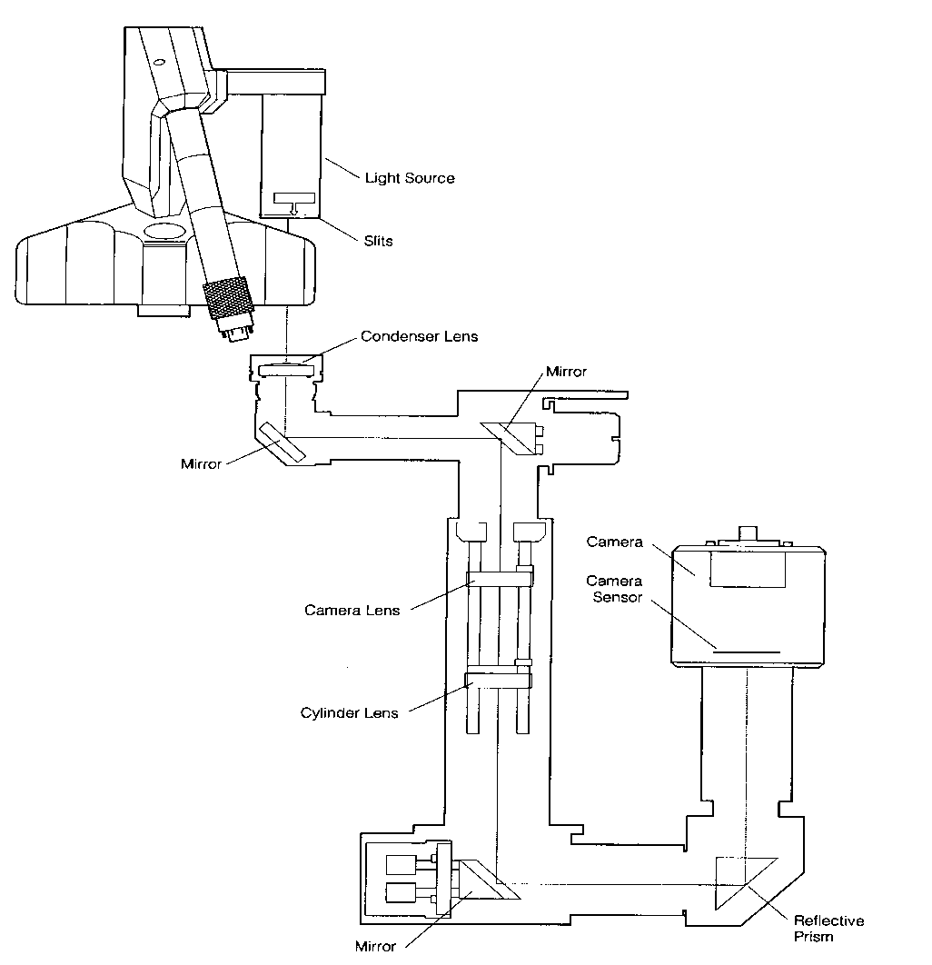
Interference optical system
Lightsource
Copyright Beckman 1996

Slide 12
Interference source
Collimating
Lens
Mask
Laser Diode
Wavefronts

Slide 13

Optical path difference
Optical path difference
Copyright Beckman 1996

Slide 14
Pathlength difference
Mask
Reference
In phase
Out of phase
n_{o}
n
Sample

Slide 15
Interference optical system
Interference
Copyright Beckman 1996

Slide 16
Pathlength difference leads to fringe displacement
Condensing
lens
d1
d1’-d2’=λ/2
d1’
ΔY= Δn l /λ
d2’
d2
d1-d2=0

Slide 17
Pathlength difference
Mask
Reference
In phase
r
Out of phase
n_{o}
n
Sample
d1 – d2

Slide 18
Optical path difference
Imaging optics
Copyright Beckman 1996

Slide 19

Superposition of images
Fringes
Cylinder lens
Cell
Camera lens

Slide 20
Interference optical system facts
Everything that contributes to d1-d2 will show up in fringe displacement
  Only need to alter d1-d2 by λ*0.01
Must use sapphire windows
Noise tends to be systematic, low frequency
∆Y= ∆n l /λ
  Shorter wavelength laser will increase sensitivity
Radial resolution 10 μm

Slide 21
Interference system ‘gotchas’
Incomplete dialysis of sample
  Buffer components contribute equally and are in much higher concentrations
  Watch out for detergents!
Improper optical focus and alignment
  Image looks fine… just inaccurate!
Inappropriate blank correction
  Water blanks should be used
  Not needed for ∆c/∆t, Sedanal

Slide 22
When to use interference optics
Buffer absorbs
Sample does not
Precision required
Extinction coefficient varies
Short columns

Slide 23
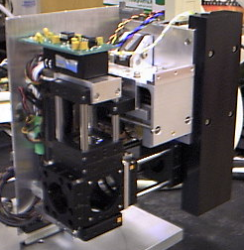
AU-FDS optics
Confocal fluorescence optics
PMT
Laser
Spatial filter
Collimation
Dichroic filter
Dichroic mirror
Expansion
Objective lens
Fluorescent event

Slide 24
AU-FDS
Excitation: 15 mW 488 nm
  Target: fluorescein-like dyes and GFP
    Protein intrinsic fluorescence not accessible
Emission: >505 nm
  Bandpass filters
Optics move as a unit
  Radial positioning by stepping motor
Objective lens focused by stepping motor
PMT
Laser
Spatial filter
Wavelength
filter
Lens assy.
Dichroic Mirror
Objective lens
Spatial filter
Fluorescent event

Slide 25
AU-FDS Synchronizing
Fluorescence
Rapid-scan absorbance
Uses a continuous light source
Acquire light intensities and rotor timing pulse
  Asynchronously with the rotor spinning
  For several turns of the rotor for averaging
Sort out the data in computer memory
Rotor timing pulse
One rotation
Intensity
Intensity from sample 1

Slide 26
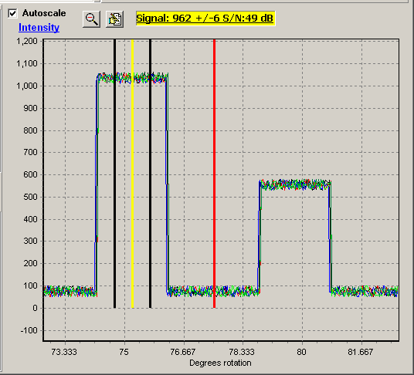
Data averaging
Multiple rotations and multiple intensities
Data for all samples
  Speeds up scanning
Signal averaging
  Multiple intensities/rev
  Multiple revolutions
1
2
3

Slide 27
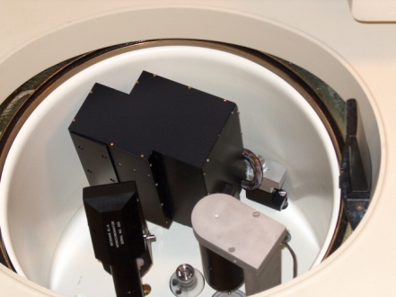
Data Collection
One radius, several rotations
FDS
FDS
One rotation
Radial
steps
Signal from samples
One rotation

Slide 28
Applications for FDS
Extrinsically labeled compounds
  488 nm excitation (fluorescein, Alexa, etc.)
  Green fluorescent protein
High selectivity and sensitivity
  Trace materials
  Complex fluids (serum, sputum, urine)
Tight associations (Kd < 10⁻⁹ M)
Broad concentration range
  3-4 orders of magnitude

Slide 29
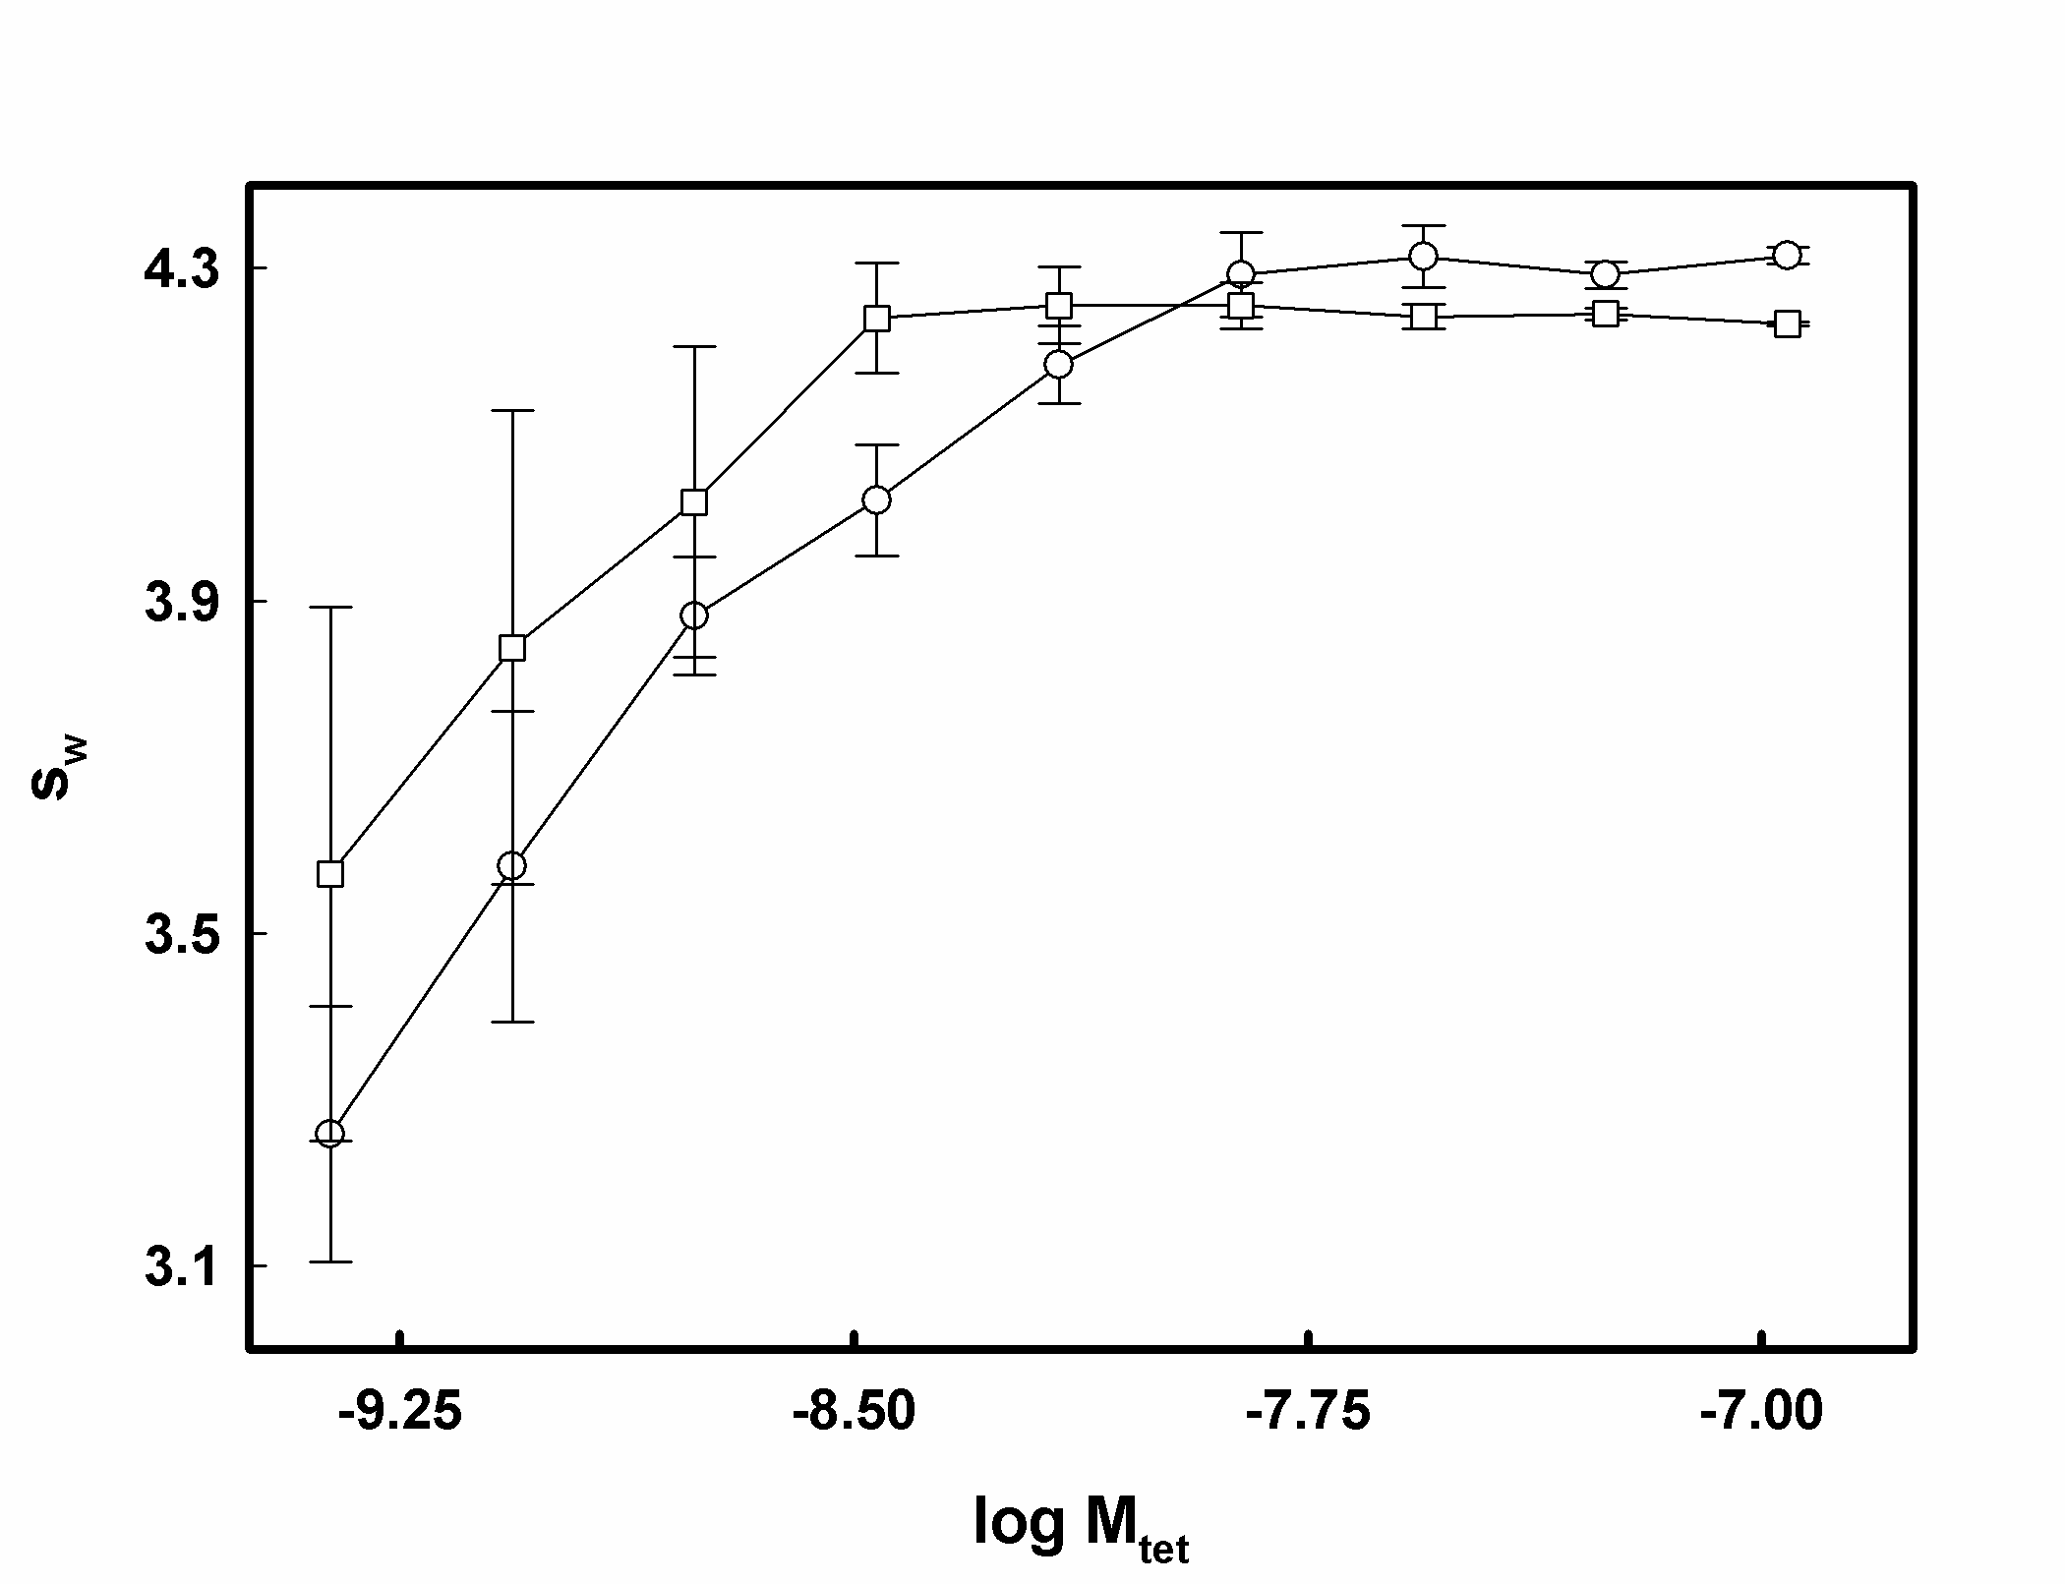
Fluorescence system gotchas
F = I_{o} Qεc
  Q is quantum yield
    Quenching- remove O₂
    Photobleaching
Have to label a molecule
  Changes to function?
Sample adsorption at low concentrations
  Meniscus, windows, centerpiece
  Makes F → c difficult to obtain
Inner filter effect
Signal roll-off at base
  Can use FC 43

Slide 30
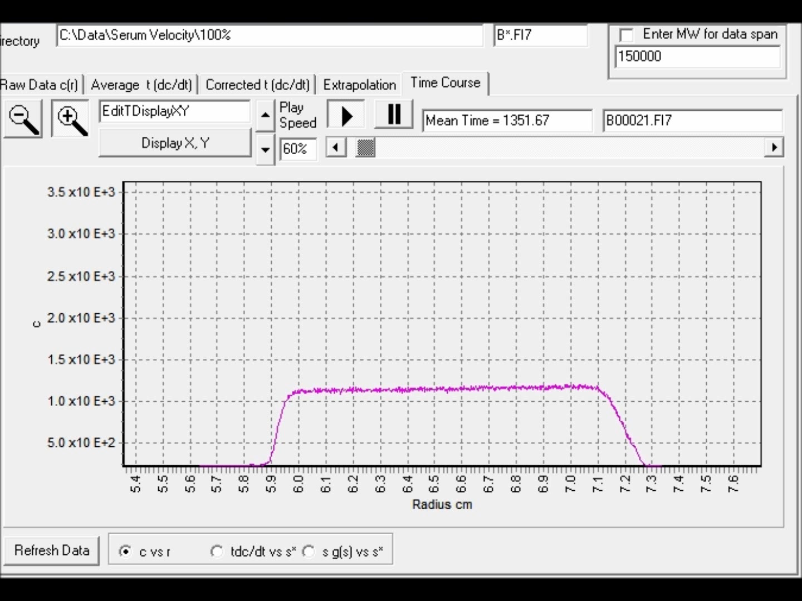
GFP in 100% Serum

Slide 31
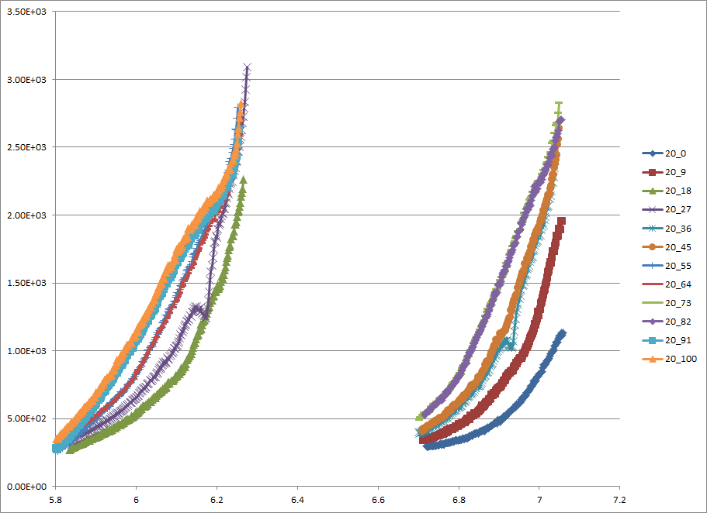
Equilibrium Scans of 40 nM GFP in Serum
Notes:
Rotor Speed (20k RPM) _ X% serum (diluted with PBS)

Slide 32
Summary

Slide 33
Summary comparison
Sensitivity Radial Resolution Scan time When to Use | Absorbance 0.1 OD 20-50 μm 1-5 minutes Selectivity Sensitivity Non-dialyzable | Fluorescence 100 pM _{fluorescein} 20-50 μm 60 seconds (all cells) Selectivity Sensitivity Non-dialyzable Small quantities | Interference 10⁻⁶ Δn 10 μm Seconds Buffer absorbs Sample doesn’t Variable ε Accurate C Short column equilibrium

Slide 34
Optical system choices by sample type and desired initial concentrations
Protein
Polysaccharide
Nucleic Acid
Choice of optics
Interference optics
Absorbance optics
1 A_{230 or 280}
C ~1 mg/ml
5 nM _{fluorescein}
1 A₂₆₀
5 nM _{fluorescein}
1 mg/ml
5 nM _{fluorescein}
 | Absorbance | Interference | Fluorescence
Sensitivity Range Precision | 0.1 OD 2-3 logs Good | 0.05 mg/ml 3-4 logs Excellent | 100 pM _{fluorescein} 3-4 logs Good

Slide 35
High concentration systems
Volume fraction and viscosity

Slide 36

High concentration effects
Molecule k affects s_{j}
Solvent flow, viscosity
Coupled flows
50 microns

Slide 37
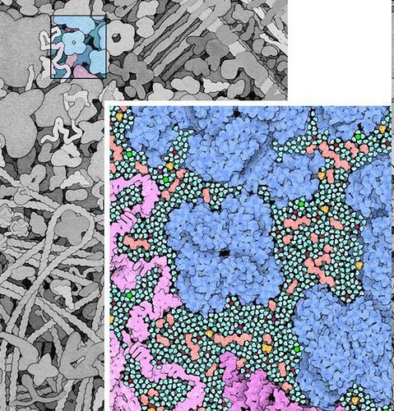
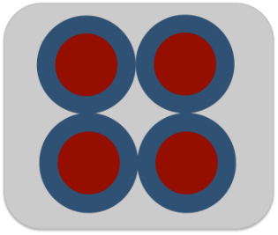
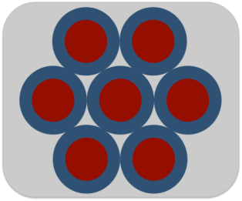
Hydrodynamics: volume fraction Φ
Separated ~20% of R
But fraction of what?
Simple CC φ = 40%
SCC max = 52.3%
R
Face CC φ = 56%
FCC max = 74%
David Goodsell

Slide 38
40 nM GFP in E. coli Lysate
Macromolecular protein solvation
s ↑ as M ↑
s ↓ as ρ↑η↑
Rachel Kroe

Slide 39
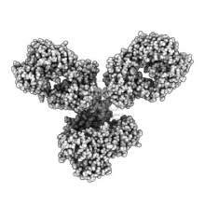
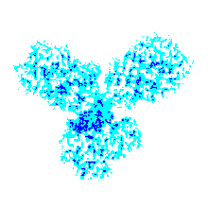
Ab:Ab interactions
Tracer IgG in high concentration IgG background
s ↑ as M ↑
s ↓ as ρ↑η↑
IgG A
IgG B
IgG C
poly IgG
IgGs in 10 mM His pH 6.0

Slide 40
IgGs solvate other IgGs
A in A
A in pIg
+
+
+
+
Trace Background
mAbA in mAbA Yes
mAbA in mAbB No
mAbA in mAbC No
mAbA in pIgG Yes
A in B or C
+
s ↑ as M ↑
s ↓ as ρ↑η↑
B in A
+
Trace Background
mAbB in mAbA Yes
mAbB in mAbB No
mAbB in mAbC No
mAbA in pIgG Yes
+
+
+
+
B in pIg
B in B or C
+
A interacts with high A
B,C interact with high A
A,B,C interact with Poly IgG
C in A
+
Trace Background
mAbC in mAbA Yes
mAbC in mAbB No
mAbC in mAbC No
mAbA in pIgG Yes
+
+
C in pIg
+
+
C in B or C
Sue Chase

Slide 41
440 pM labeled RANKL
+ varying mAb in PBS
Lattice overshoot kinetics
s ↑ as M ↑
s ↓ as ρ↑η↑
Hill JJ & Laue TM (2015) “Protein assembly in serum and the differences from assembly in buffer.” Methods in Enz. 562, pp. 501-527

Slide 42
19 nM labeled Anti RANKL + 85 nM RANKL
in PBS
in Serum
IgG binds to serum component
No large complexes!!
Hill JJ & Laue TM (2015) “Protein assembly in serum and the differences from assembly in buffer.” Methods in Enz. 562, pp. 501-527

Slide 43
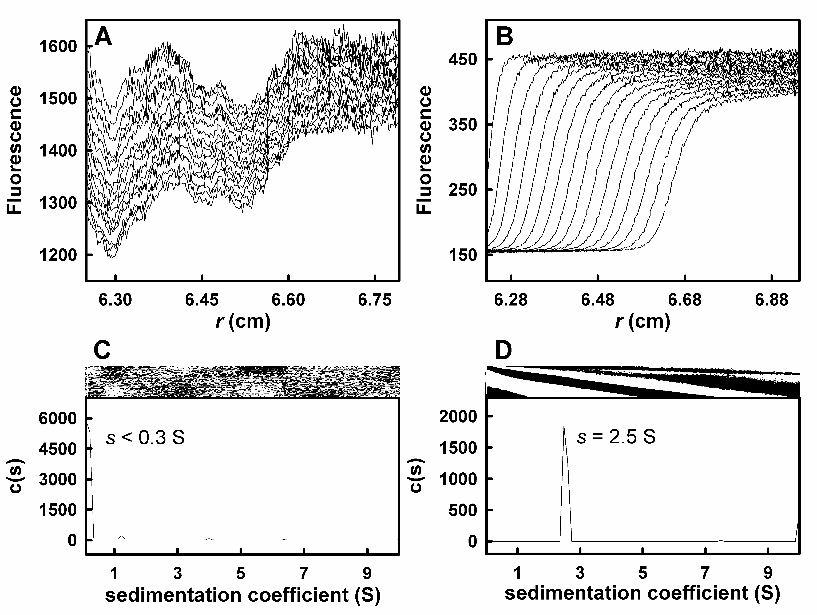
Albumin binds fluorescein weakly
0.1 mg/mL BSA
100 mg/mL BSA
PBS, pH 7, 1 μg/mL Fluorescein
Jon Kingsbury

Slide 44
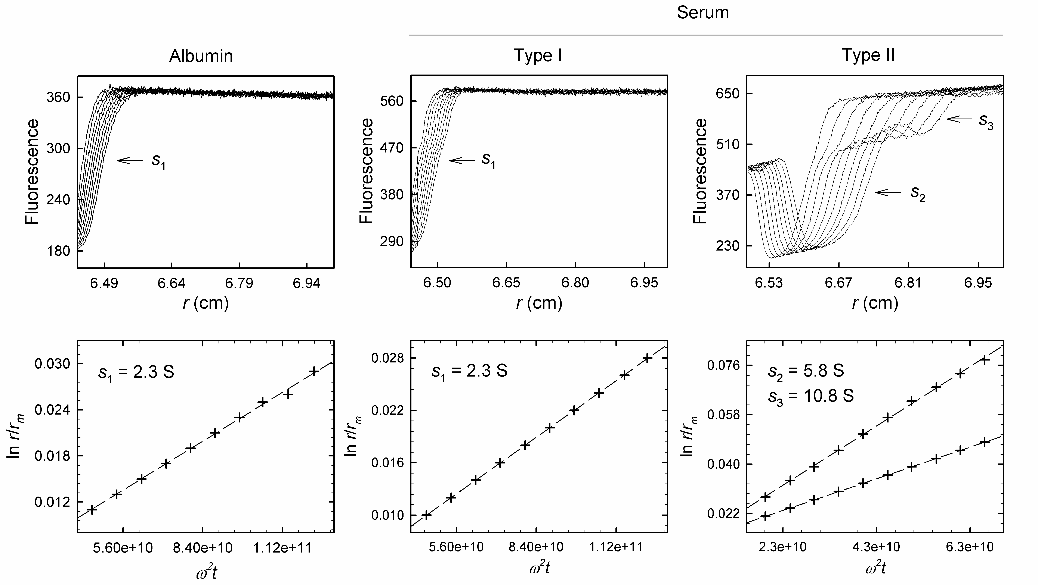
Fluorescein in PBS and serum

Slide 45
Example of J-O effect
550 nM GFP in serum

