Slide 1
AUC Fundamentals
Analytical Ultracentrifugation Workshop
2022

Slide 2
Outline
General considerations
Sedimentation velocity
  General information
Sedimentation equilibrium
  General information
Practical issues

Slide 3
An AUC experiment consists of…
The setup
  Rotor
  Cells
    Centerpieces
  Optical systems
    Windows
Method
  Sample concentration range
  Temperature
  Rotor speeds
  Number of scans
  Delay before scans
  Interval between scan
Compatibility with sample and method
Optimizing information content

Slide 4
An AUC experiment consists of…
Analysis
  Velocity: Size distribution
  Velocity: Discrete species
  Equilibrium: Thermodynamics
Interpretation
  Solvent properties
    Density, viscosity
    pH
    Ionic strength
  Solute properties
    Buoyancy factor
    Signal → concentration conversion
    Size, asymmetry
Sedanal, Sedfit, UltraScan, Dcdt+
Sedphat, Svedberg. UltraScan
HeteroAnalysis, Nonlin, Sedphat, Ultrascan
Measure or calculate
Sednterp, Sednterp2, UltraScan,
Sedfit

Slide 5

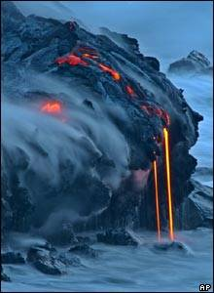
What do you want to know?
Difficulty
Sample
Size distribution
Stoichiometry- single component
Reaction reversibility
Stoichiometry and energetics
  Self association
  Hetero association
Easy
Less
Hard
More

Slide 6
General Sample Handling
Gel filter sample prior to analysis
  Unless the question being addressed is “What’s in a solution”
Estimate concentration and volume
Dialyze sample: equilibrium with solvent
  May be problematic with detergents
  Required for interference optics, not with others
Choose centerpiece material and window types
  Interference requires sapphire windows
  Sapphire good for all optical systems
  Charcoal epon quite “inert” for sedimentation velocity
  Kel-F for sed equilibrium (lower g-force)

Slide 7
Sample Handling
Sample Arrives
Gel filtration needed?
General Sample Handling
Estimate concentration and volume
Choose optical system
Sample dialysis?
Sedimentation Velocity
Choose rotor speed
3 concentrations
Sedimentation Equilibrium
Short column
"Long" column
Quick survey
Detailed analysis
Heteroassociations
Low molecular weight
Titrations
Heterogeneity
Notes:
Run guanidinium-treated sample to get assembly stoichiometry
Use FC-43 for all sedimentation equilibrium runs
Only put into sample channel
5 uL/channel for short columns
10 uL/channel for “long” columns

Slide 8
Optical system choices
Protein
Polysaccharide
Nucleic Acid
Choice of optics
Interference optics
Absorbance optics
1 A_{230 or 280}
1 A₂₆₀
50 nM _{fluorescein}
C > 0.1 mg/ml
50 nM _{fluorescein}
1 mg/ml
50 nM _{fluorescein}
 | Absorbance | Interference | Fluorescence
Sensitivity Range Precision | 0.1 OD 2-3 logs Good | 0.05 mg/ml 3-4 logs Excellent | 100 pM _{fluorescein} 3-4 logs Good

Slide 9
Summary comparison
Sensitivity Radial Resolution Scan time When to Use | Absorbance 0.1 OD 20-50 μm 60 – 300 seconds Selectivity Sensitivity Non-dialyzable | Fluorescence 100 pM _{fluorescein} 20-50 μm 90 seconds (all cells) Selectivity Sensitivity Non-dialyzable Small quantities | Interference 10⁻⁶ Δn 10 μm 1 second Buffer absorbs Sample doesn’t Variable ε Accurate C Short column equilibrium

Slide 10
Sedimentation velocity
S
D

Slide 11
Distance moved by s & D
For s = 5 x 10⁻¹³ s = v/a
At 60,000 rpm, ω² = 3.959x10⁷/s²
at 6.5 cm ω²r = 2.57x10⁸ cm/s²
v = 5x10⁻¹³*2.57x10⁸ cm/s²
v = 2.5x10⁻⁵ cm/s or 0.25 µm/s
Sediments ~0.25 µm in 1 s
For D = 5x10⁻⁷ cm²/s
<x> = (2Dt)^{1/2}
in 1 second <x> = 1x10⁻³ cm
Diffuses ~10 µm in 1 s
Optical resolution limit

Slide 12
Choosing a rotor speed
Component resolution improves as ω² (i.e. rpm²)
  Resolving power of sedimentation velocity = h∙ ω² where h = solution height
Need sufficient scans for analysis
  What is sufficient?
    20 minimum
    2 hours top to bottom if possible
Avoid boundary shifting significantly during a scan
  What is significantly?
    < Optical resolution

Slide 13
Resolving power
c(s) analysis on simulated data
c(s)
S
Figure Courtesy of Steve Berkowitz

Slide 14
Selecting rpm
Velocity versus rpm
Time to move 1.5 cm
2 hours
Optical resolution

Slide 15
Time needed to move 100 μm
Sets the maximum resolution in s.

Slide 16
Sedimentation velocity
Balance of forces
v
fv
  M_{p}a
  M_{s}a
Experimental definition
Molecular definition

Slide 17
QAD analysis
Just look at the data
Non-sedimenting material?
Plateau sloped?
Multiple boundaries?

Slide 18
Effect of shape on S
S = M_{b}/f f = 6πξRs
For a given mass, a more symmetrical shape will sediment faster

Slide 19
Effect of shape on S and D

Slide 20


Hydrodynamic nonideality
As macromolecule sediments, solvent must take its place
50 microns

Slide 21
Hydrodynamic nonideality
Concentration dependence: hydrodynamic nonideality
Solvent counter-flow affects adjacent molecules
50 microns

Slide 22
Effect of concentration on S and D
High concentration
Dilute
s higher
s
s lower
c

Slide 23
Extrapolate s and D to c = 0
Expressed as s(c) and D(c)
Extrapolate s and D to get standard values
sº = s_{c → 0} and Dº = D_{c → 0}
s_{o}/s
D_{o}/D
Slope = k_{s}
Slope = k_{D}
[c]
[c]

Slide 24
Shape and concentration effects on s

Slide 25
What are f and f/f_{o}?
f = 6πηR_{S}
  For non-stick conditions f = 4πηR_{S}
What is R_{S}?
  “The radius of the equivalent sphere.”
  From the Navier-Stokes equation
    Conservation of mass, energy, linear and rotary momentum
    Primary charge effect for low ionic strength (< 1 mM)
f_{o} is an ad hoc reference state
  Anhydrous sphere with of volume Mv-bar
  Based on Teller radius, f_{p}
f/f_{o} is mostly about molecular asymmetry
  A fitting parameter linking s to M
  Empirical relationship shows that f/f_{o} ~1.2 for spherical molecules

Slide 26
Viscosity
Newtonian
η/c
v=0
F due to transfer of momentum
Non-Newtonian
Useful with very large particles
Gross shape information
Depends primarily on shape (axial ratio)
v
Sphere
Rod
η/c
Axial ratio

Slide 27
Mechanics of viscosity
v=0
Deformation of liquid is shear
Shear strain dx/dy
Shear rate is dv/dy (s⁻¹)
Shear stress F/A, force g-cm/s²/cm²
A liquid subjected to constant shear stress will shear at a constant rate so long as the force is maintained

Slide 28
Viscosity: different views
Shear stress, σ, is related to rate of shear strain
σ = η d/dy(dx/dt)
  η is the viscosity
    Proportionality factor shear stress to the gradient in the fluid velocity
η = Rate of energy dissipation in flow
  dW/dt = (dv/dt)² η
  Units of η g/cm-s, called Poise
  Water at room temperature 0.01 P, or 1 cP

Slide 29
“Kinds” of viscosity
η ← Absolute viscosity σ = η d/dy(dx/dt)
η/η_{o} ← Relative viscosity
  Relative to the solvent viscosity η_{o}
η/ρ ← Kinematic viscosity
  Comes from Navier-Stokes equation
(η- η_{o})/η_{o} ← Specific viscosity
(η- η_{o})/η_{o}C ← Reduced specific viscosity
lim_{c→0} (η- η_{o})/η_{o}C = [η] ← Intrinsic viscosity
  lim_{c→0} (η- η_{o})/η_{o}C = lim_{c→0} ln(η/η_{o})/C

Slide 30
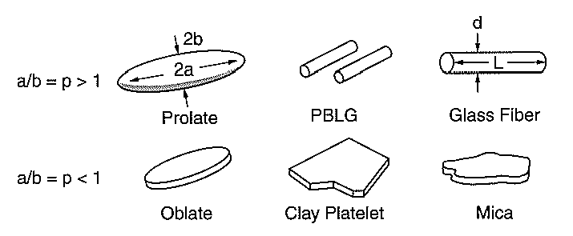
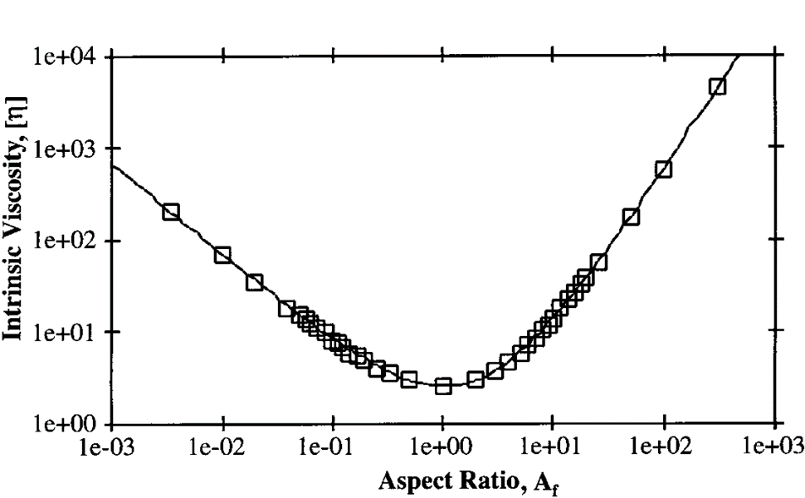
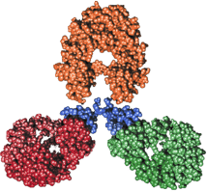

Intrinsic Viscosity of Ellipsoids
The aspect ratio A_{f} & particle asymmetry.
A_{f} > 1 for prolate ellopsoids (limit: fiber)
A_{f} = 1 for spheres
A^{f} < 1 for oblate ellipsoids (limit: plate).
MAbs
A_{f} ≈ 5.25
[h] = 6.31
J. F. Douglas and E. J. Garboczi, Adv. Chem. Phys., 91, 85–153 (1995).
Adapted from Bicerano et al, J. Macromol. Sci., Part C: Polymer Rev., 39 (4) (1999)

Slide 31
Sedimentation velocity protocols
If you know nothing about the size distribution
  Start the machine at 3000 rpm
  Watch for sloped plateau and boundary shape
Resolution of components increases as H and ω²
  Fill the cells as full as possible
  Run as fast as possible
Wait for T to stabilize before starting
  T gradient will develop during acceleration- dissipates in minutes
Run 3 concentrations spanning as wide a range as possible
Initially run at 20 ºC to simplify analysis.
If interacting system is being characterized
  Concentration range may need to be higher
  Vary molar ratio of components
  May use multiple temperatures to dissect the association energetics.

Slide 32
When to choose equilibrium
Solution average molecular weight
Stoichiometry of complexes
Association constants
  Discrete assembly scheme
Characterize thermodynamic nonideality
  No hydrodynamic nonideality

Slide 33

Sedimentation Equilibrium
A balance of fluxes
At equilibrium
Intuitive, but not energetically rigorous

Slide 34
Sedimentation Equilibrium
A balance of energies
Gravitational
potential gradient
Chemical
potential gradient
At equilibrium

Slide 35
Sedimentation Equilibrium
A thermodynamic view
dρ/dc₂ at constant chemical potential is the correct buoyancy
term
We are counting particles in sedimentation equilibrium, not
weighing them

Slide 36
Golden rules of sedimentation equilibrium
Examine at least 3 loading concentrations
  Span ~1-log range (e.g. 1:1, 1:3, 1:9 dilutions)
Examine at least 3 rotor speeds
  Cover the range of ~2 < σ < ~10 (monomer)
  Adjust this range for associating systems.
For hetero-associating systems
  Characterize each component separately
  Vary mole ratio of components
  Vary total concentration at each mole ratio

Slide 37
AUC Fundamentals
Practical considerations

Slide 38
Suppose you head a facility
What kind of macromolecules are we dealing with?
What is in the solvent?
How much sample do you have
  Or get your hands on?
What awful behavior does your molecule exhibit that you are reluctant to tell me about?
How will you react if the sedimentation results don’t match your working hypothesis…
  Or your delusional molecular fantasy?
What are going to do to me if it gets sucked into the vacuum system?

Slide 39
Proteins- general
What kind of macromolecules?
v-bar
frictional coefficient
What is the amino acid composition?
  Is it highly charged and small?
  Globular of fibrous?
Is it conjugated?
  With what?
  How much?
Absorbance characteristics?
  Fluorescence characteristics?
Soluble? In what?
  Be alert for the phrase “it loses activity if…”
Is it alone, or did it bring its buddies with it?
  How is the sample purified?
  Is GPC part of the purification protocol?
  What tests for purity are used?
M, v-bar
frictional coefficient
Which detector to use
density, v-bar
aggregation
Expectations

Slide 40

Proteins- self association
What kind of macromolecules?
Molecular weight &
Concentration range
Optical system
Is it known (expected) to self associate?
  What is known about the association stoichiometry?
  What is known about the strength of association?
Is the self association ligand-linked?
  What is the mass/association characteristics of the ligand?
  Will the ligand interfere with any of the optical systems?
What questions do you want answered by sedimentation?
  E.g. reversibility of the reaction
    Time scale of reversibility
  Homogeneity of association
  Effect of ligand on association
  Strength and stoichiometry of association
  Linkage energy between ligand and protein association
Molecular weight
Number of components
Optical system

Slide 41
Proteins- hetero association
What kind of macromolecules?
All of the questions above must be asked about each component.
Each component needs to be characterized individually
Are they known (expected) to associate?
  What is known about the association stoichiometry?
  What is known about the strength of association?
  Do the components self associate?
Is the association ligand-linked?
  What is the mass/association characteristics of the ligand?
  Will the ligand interfere with any of the optical systems?

Slide 42
Polysaccharides
What kind of macromolecules?
What is the composition?
  Is it charged or neutral?
  Does it have any chromophores?
Be prepared for severe hydrodynamic nonideality.
  Characteristics are best determined by extrapolation to [C]→ 0
If charged, be prepared for severe thermodynamic nonideality, too
Optical systems
Expectations
Expectations

Slide 43
Nucleic acids
What kind of macromolecules?
Be prepared for severe hydrodynamic and thermodynamic nonideality.
  Characteristics are best determined by extrapolation to [C]→ 0
The partial specific volume of highly charged molecules depends on the solvent composition
  Best off determining vbar if possible
Expectations
M, vbar
Expectations

Slide 44
Others kinds of molecules
What kind of macromolecules?
Nearly any system will benefit from characterization by sedimentation
Hetero-associations (e.g. protein-DNA)
Small molecules: drugs, ligands, gasses
  Is it monomeric?
  Can approximate vbar from composition/density
Large aggregates: viruses, organelles
Be fearless!!
vbar
Expectations

Slide 45
What is in the solvent?
Compatibility with centerpiece
Does it absorb UV?
  BME, DTT, unreduced Triton X100
  Nucleotides, flavones
What is the solvent viscosity and density?
  Salts and neutral molecules will affect density
  PEG, glycerol affect viscosity strongly
Will any of the solvent components sediment significantly?
  Will the gradients matter biochemically?

Slide 46

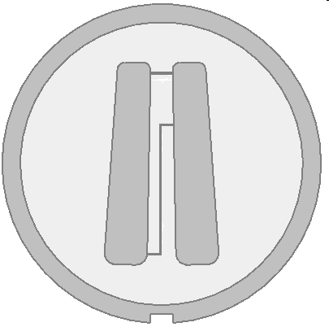

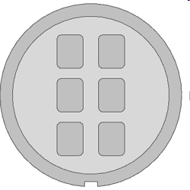

Centerpieces
Spin60K
Spin50K
Meniscus
matching
4-channel
Velocity/Equilibrium
6-Channel
Equilibrium
12 mm
3 mm
1 mm
Synthetic
boundary
Band forming
Charcoal-filled Epon
Aluminum-filled Epon
Aluminum
Titanium

Slide 47
Windows and holders
Absorbance
Fluorescence
Window
Sapphire
Fused silica
Window cushion
Plastic
Interference
Top
Window liner
(gasket)
Plastic
Window holder
Aluminum
Interference
Bottom

Slide 48
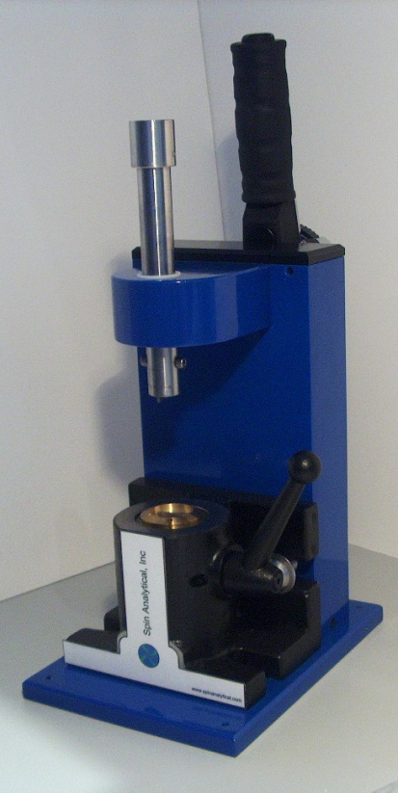
Cell assembly
Lube
Screw ring
Housing thread
Rotor hole
Torque to 130
Torque slowly
Torque 3 x
If “chattering,” re-lube
Re-torque after ΔT
Use softer gasket
Teflon, neoprene
Hex-head screws
Torque screwdriver

Slide 49
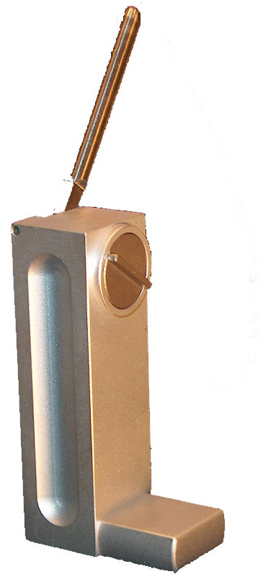
Cell alignment in rotor
Spin Optical alignment tool
Gabrielson J, Randolph TW, Kendrick BS and Stoner MR (2007) “Sedimentation velocity analytical ultracentrifugation and SEDFIT/c(s): Limits of quantitation for a monoclonal antibody system” Anal. Biochem. 361:24-30.
< ±0.2º to prevent false peaks
Limits of visual detection
Rely on accuracy of centerpiece
Scribe lines mark cell housing center
Want cell walls radially directed
Tool provides reproducibility
Require accuracy
Optical alignment tool
  Tool to test alignment

Slide 50


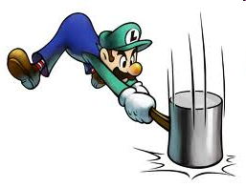
Component and cell press
Arbor presses
Designed specifically to ‘press’ out
  Cells from rotors
  Cell components from cell housings

Slide 51
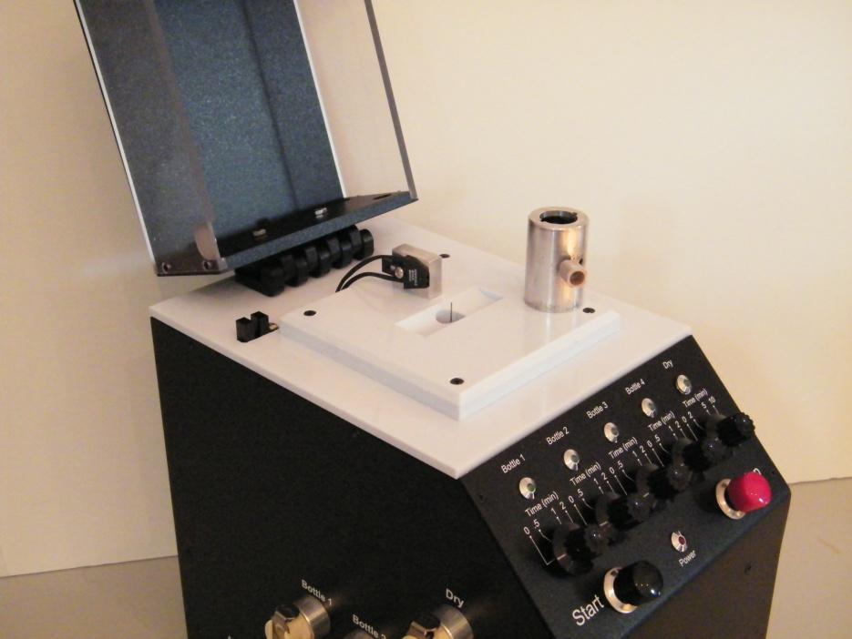
Cell washer
Rinse, wash, rinse, dry
Press start & walk away
  < 10 minutes/channel
Compatible with
  2 M HCl, 2 M NaOH
  Hellmanex
  SDS, RBS
  Alcohols
Spin or Beckman 2-channel cells
  Spin 4-channel cells
  Not flow-through cells

Slide 52
AUC Fundamentals
Data interpretation

Slide 53
Correcting for Buoyancy
M_{B} = M (1 - vρ )
  M is the anhydrous molecular weight
  v is the partial specific volume
  ρ is the solvent density
Using neutral buoyancy
  Set 1-v_{i}ρ = 0 for a component
  Useful with detergents

Slide 54
Determining ρ
Depends on solvent component concentrations
Depends on T
Estimation from buffer concentration
  Adjust to T using H₂O r(T)
  Best if only one component in high concentration
Measurement
  Pycnometry, density meter, etc.

Slide 55
Partial Specific Volume
Measure, but more frequently calculated
  Depends on composition
  Depends weakly on T
    v_{T} = v₂₅ + 4.25x10⁻⁴ (T – 25)
  Highly charged proteins need adjusting
    v smaller than calculation
Depends on solvent composition
  Special care needed for high C components
  Worked out for 6 M Gdn and 8 M Urea

Slide 56
The buoyancy factor is (dρ/dc₂)_{μ}
(1-vρ) is an approximation, only valid for a 2-component system
  I.e. mass of solvent displaced is M₂vρ, leading to the buoyant force
Gravitational field really acting on volume elements of the solution
  correct term in place of (1-vρ) is dρ/dc₂
For dialysis equilibrium, (dρ/dc₂)_{μ}

Slide 57
When to worry about using (1-vρ)
High concentration of co-solvent
  e.g. 8 M Urea, 6 M GdHCl
Significant binding of a solvent component to the solute
  e.g. Detergent with a protein
The solvent used for determining v differs from the solvent used in the experiment
  E.g. the v from Sednterp is for the anhydrous molecule, so M is the anhydrous molecular weight

Slide 58
Detergent-solubilized proteins
Make the solvent density match the v of the detergent,
  M is the anhydrous molecular weight
Tables of detergent v available
If possible, use D₂O to match density
  Use of other solvent components (e.g. salt, sugar) to match density may be problematic due to preferential solvation effects
Be careful if K is to be measured in detergents

Slide 59
So what does M refer to in a multi-component solution?
Suppose you dissolve NaDNA in a solution of CsCl does M₂ refer to NaDNA or CsDNA or some in-between mixture?
Depends c₂ when you measure dρ/dc₂
  If c₂ is measured as the g/ml of NaDNA added to a solution of CsCl, then M refers to NaDNA.

Slide 60
Correcting Viscosity
η affects velocity directly
  Affects time to reach equilibrium
η depends on T and composition
  η decreases ~4% per ºC increase
  Composition effect is small for salts
    Organics (e.g. glycerol) can have large effect

Slide 61
Summary
Adjusting s for solvent effects
Adjust to standard conditions
Standard conditions are water at 20 ºC
s = M(1-vρ)/Naf and f = 6πηRS
  v = v(T), weak function
  ρ = ρ(ci,T), ci stronger than T
  η = η(ci,T), both ci, T strong
Use Sednterp
Ad hoc

